Slide 1
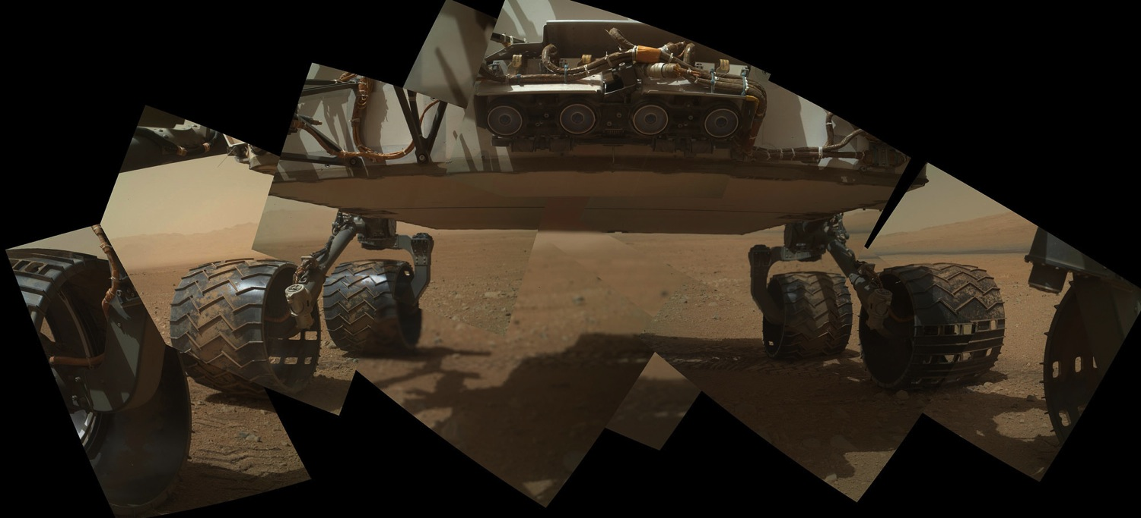
Working on the Curiosity Mars rover
NASA/JPL-Caltech/MSSS
Nina Lanza and Agnes Cousin
Expanding Your Horizons
Santa Fe, NM
2 March 2013
LA-UR-13-21424

Slide 2
Who are we and what do we do?
Nina Lanza & Agnes Cousin
Geologists and postdocs
Recently finished PhD, still in training
Los Alamos National Laboratory (LANL) in NM
On MSL ‘Curiosity’ rover science team
ChemCam instrument

Slide 3
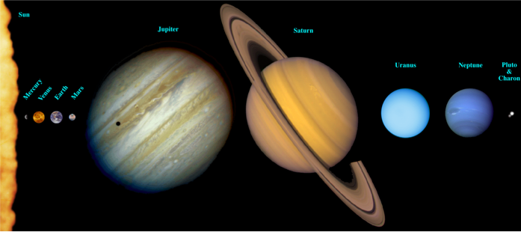
Where’s Mars?
(Not to scale!)

Slide 4
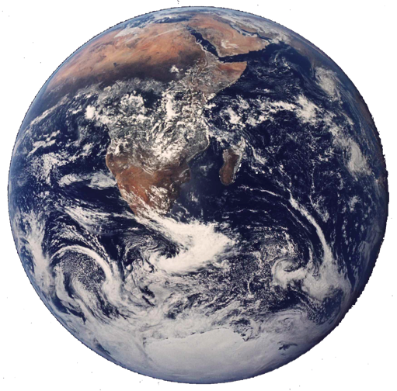
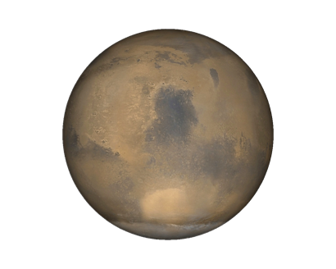
Planet | Equatorial Diameter | Mass | Rotation
Earth | 12,756 | 1 | 23h 56 min
Mars | 6,792 | 0.107 | 24h 37 min

Slide 5
What do we know? Differences between Earth and Mars

Slide 6
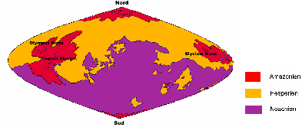
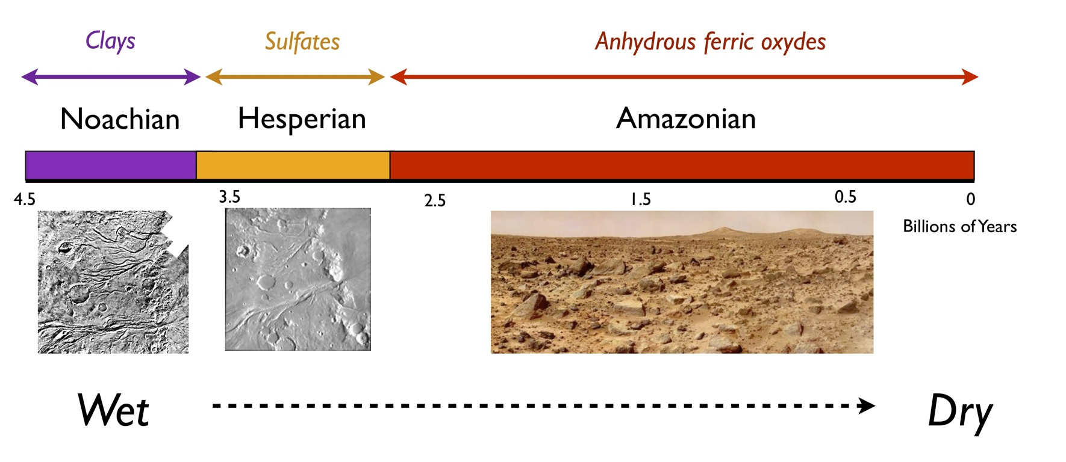
Mars: An ancient surface
Water on Earth
Life on Earth
Average age of Mars’ surface
Average age of Earth’s surface
Notes:
Mars est marquée par 3 gdes ères géologiques :
- le noachien, qui correspond à la fin de la période d'accrétion, avec déjà la formation de structures fluviatiles. Cette période est celle que l'on appelle "Early Mars", où Mars était encore chaude et humide,
- l'Hespérien, qui est une ère durant laquelle le volcanisme était bien en place. Les vallées de débâcles sont importantes et nombreuses à cette période.
- Enfin, l'Amazonien, depuis 2.9 GA, est marqué par la formation des calottes polaires. Le dôme de Tharsis est encore en évolution, et les vallées de débâcles ont encore lieu. Cette période correspond à "Mars sèche".
Différents types de terrains caractérisent ces 3 ères. Le noachien est riche en argiles, avec une transition vers des sulfates à l'Hespérien. L'amazonizn est lui caractérisé par la formation d'oxydes de fer.
Sur Terre, la présence de vie est confirmée à 2.7 GA, avec l'observation des stromatholites. L'eau quant à elle est présente dès 4.2 GA d'après les zircons.
L'observation de ces terrains très anciens sur Mars, impossible sur Terre à cause de la tectonique, fait de cette planète un livre ouvert sur notre passé. L'étude de l'habitabilité passée de Mars est celle oubliée sur Terre, et c'est dc ainsi nos origines également que l'on chercher sur Mars.

Slide 7
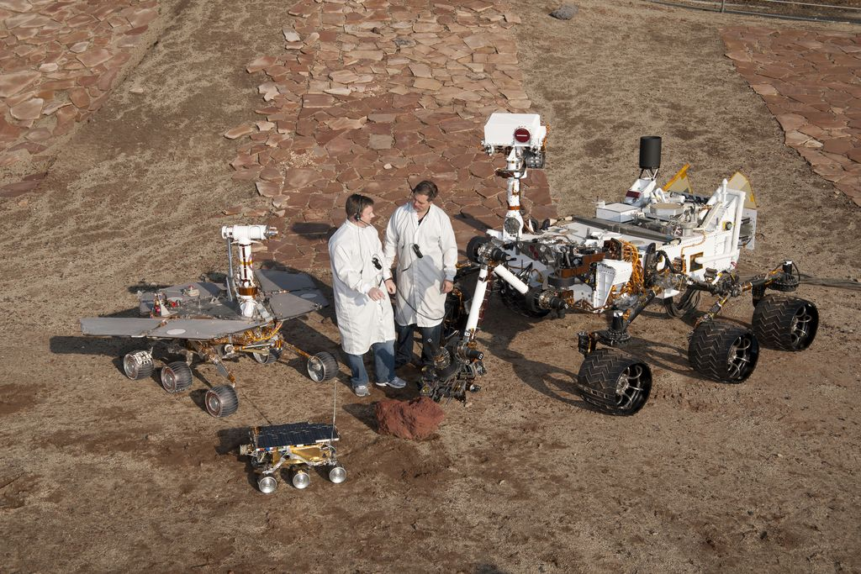
Mars Science Laboratory (MSL) ‘Curiosity’
MSL (2011)
Curiosity
MER (2003)
Spirit and Opportunity
Pathfinder (1996)
Sojourner

Slide 8

Goals of MSL
To assess the past and present habitability of the martian environment
Not a search for life per se
Environments in which life could exist
H₂O (key criterion for life)
Hydrated and water-formed minerals
Organic materials
Other bio signatures (chemical or morphological)

Slide 9
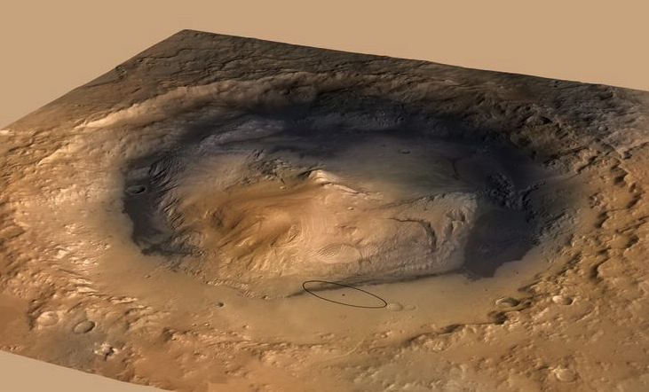
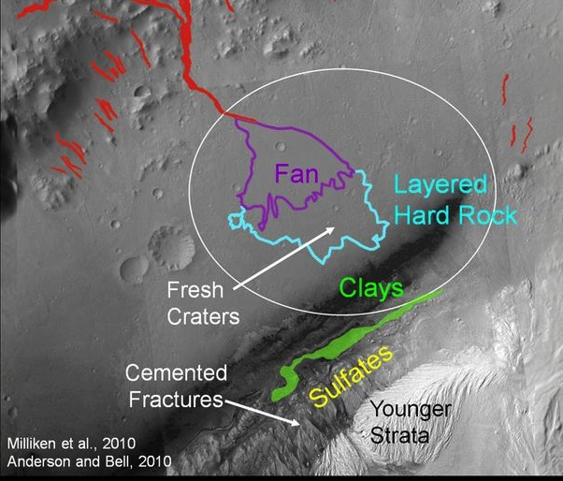

Landing site: Gale crater
Aeolis Mons (‘Mt. Sharp’) ~5.5 km tall
Crater diameter ~150 km
NASA/JPL-Caltech
Ellipse ~20 x 7 km
NASA/JPL-Caltech/ESA/DLR/FU Berlin/MSSS
Life on Earth

Slide 10
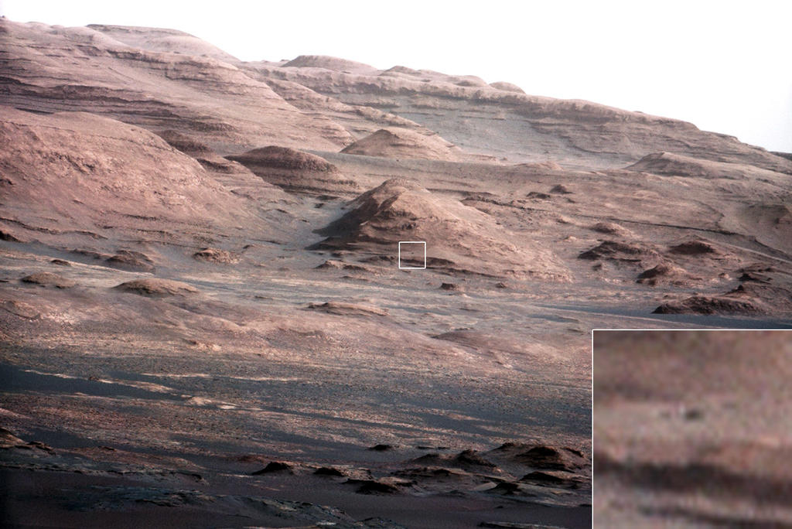
Layers of Mt. Sharp
Layers = geologic time
(Grand Canyon)
Younger materials
Rover-sized boulder
Older materials
NASA/JPL-Caltech

Slide 11
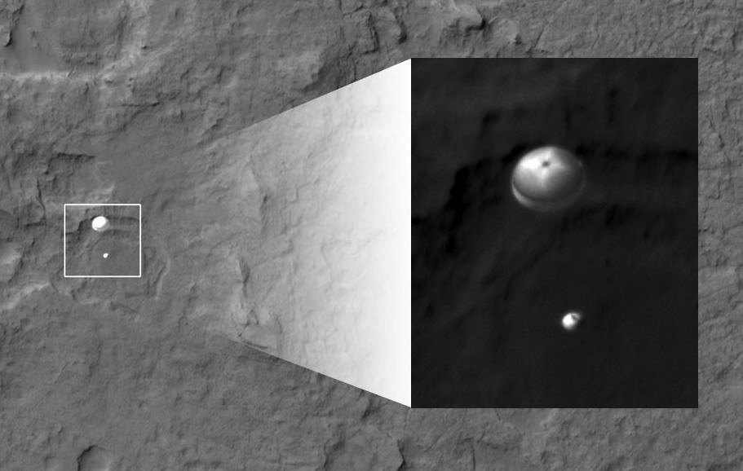
Curiosity lands on Mars Imaged by HiRISE on Mars Reconnaissance Orbiter
Curiosity on parachute, imaged by
HiRISE on the Mars Reconnaissance Orbiter
NASA/JPL-Caltech/Univ. of Arizona

Slide 12
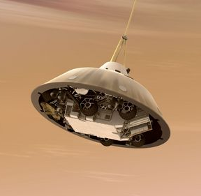
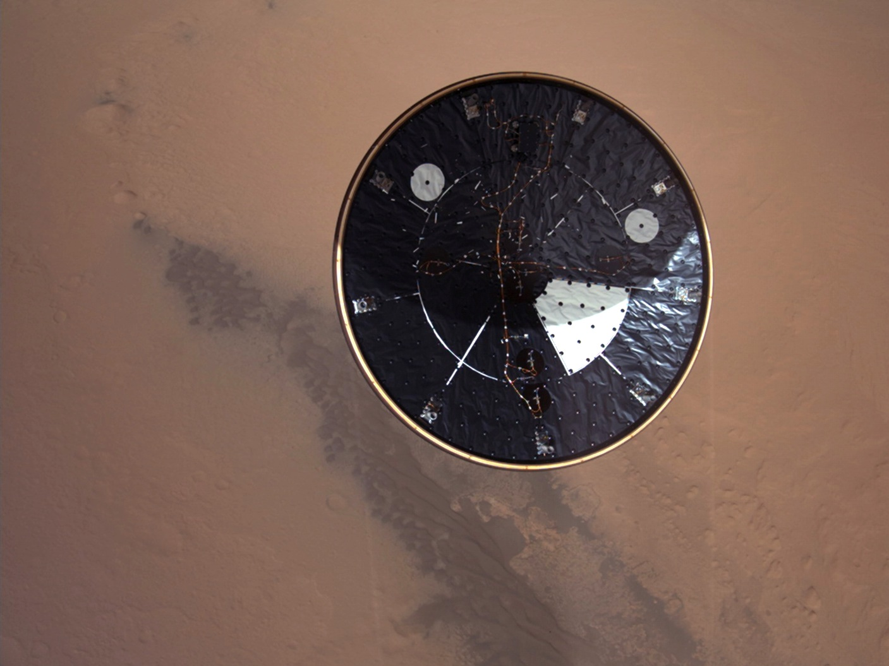
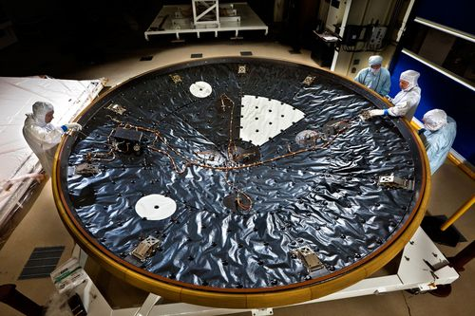
Heat shield separation Mars Descent Imager (MARDI)
NASA/JPL-Caltech/MSSS

Slide 13
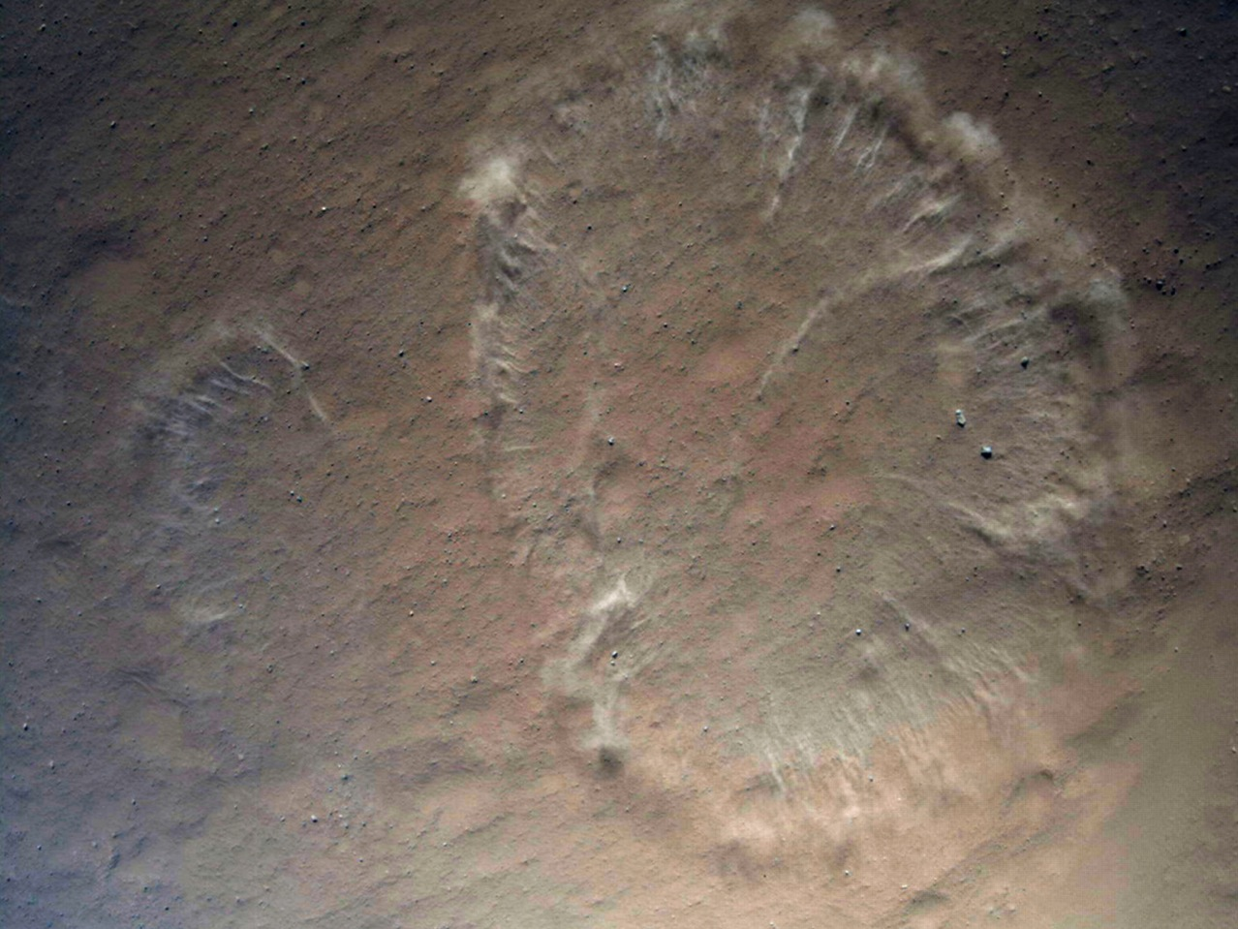
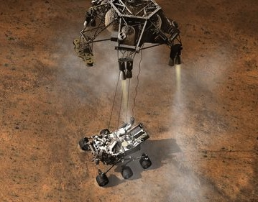
Just prior to landing
NASA/JPL-Caltech/MSSS

Slide 14

MARDI descent video

Slide 15
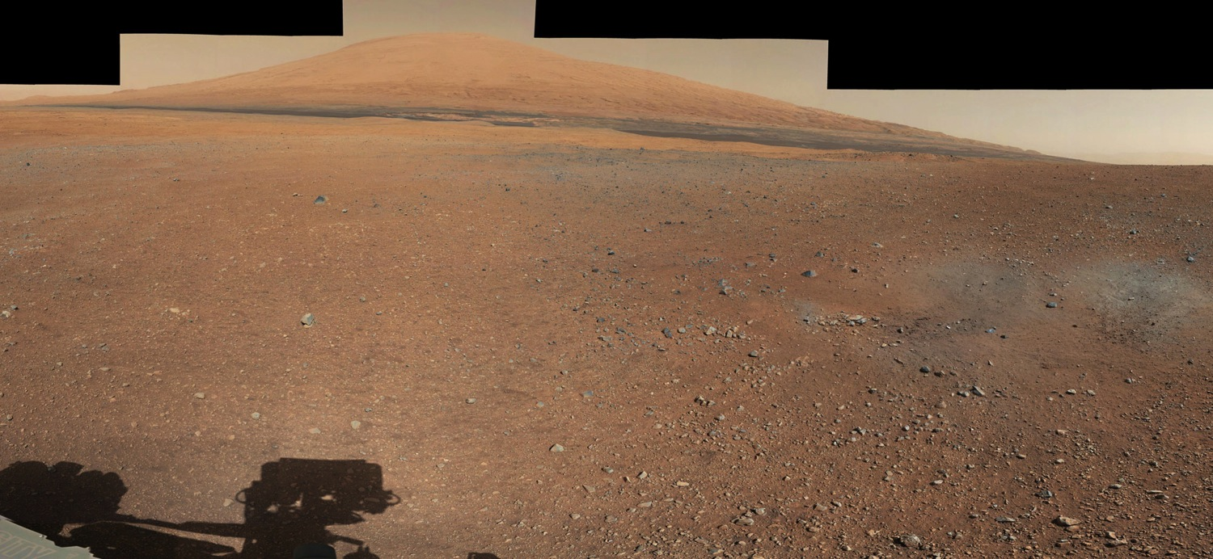
View of Mt. Sharp from landing site Mastcam image
NASA/JPL-Caltech/MSSS

Slide 16
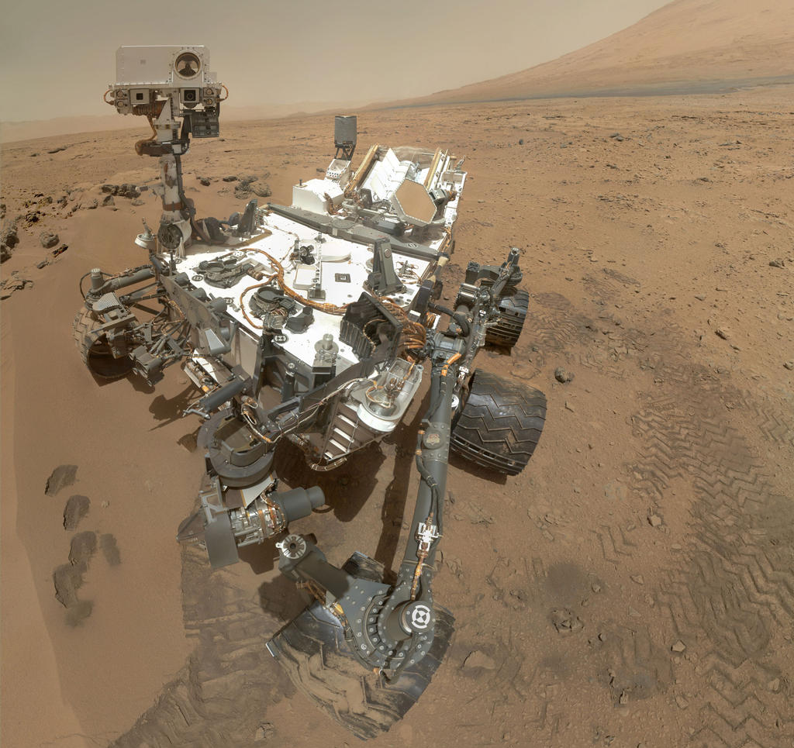
Self-portrait with MAHLI
NASA/JPL-Caltech/MSSS

Slide 17
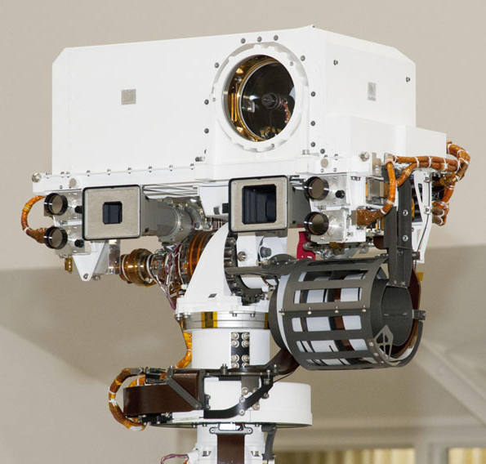
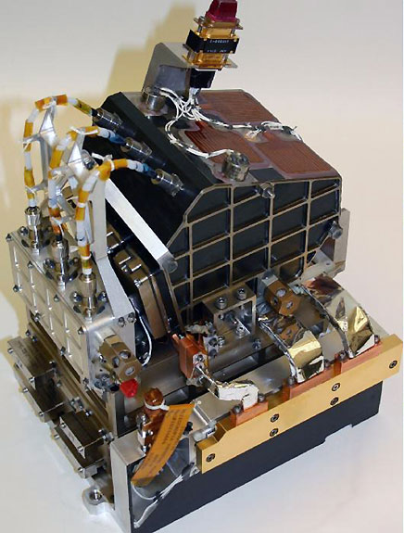
Self-portrait with MAHLI
ChemCam (mast unit)
ChemCam body unit (inside rover body)
NASA/JPL-Caltech/MSSS

Slide 18
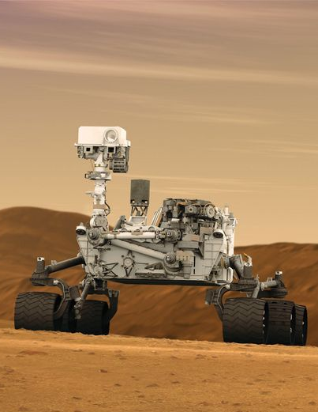
ChemCam Chemistry and Camera
Composed of two instruments
Remote laser-induced breakdown spectroscopy instrument (LIBS)
Remote Micro Imager (RMI)
LIBS determines elemental compositions up to 7 m from rover
RMI provides telescopic context images
Resolution of objects <0.5 mm diameter at 5 m distance
Small scale textural information

Slide 19
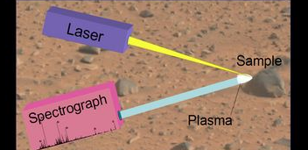
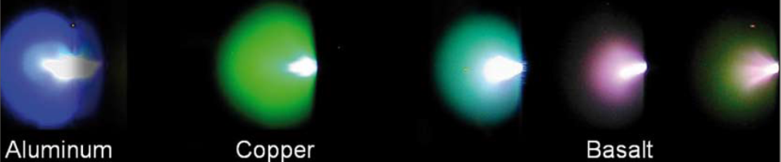
What is LIBS?
Laser-Induced Breakdown Spectroscopy
Ablation (emission) spectroscopy technique
Uses pulsed laser
λ = ~1067 nm (NIR)
Heats target to ~6000-9000 K and turns surface materials into plasma (ablation)
Spectrometer collects light from plasma over ~200-800 nm (UV, VIS, NIR)
Returned spectra have peaks that correspond to specific elements → different colors of light

Slide 20
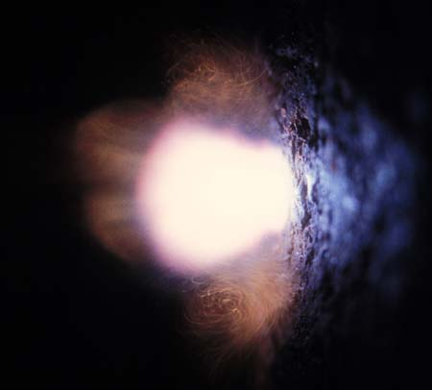
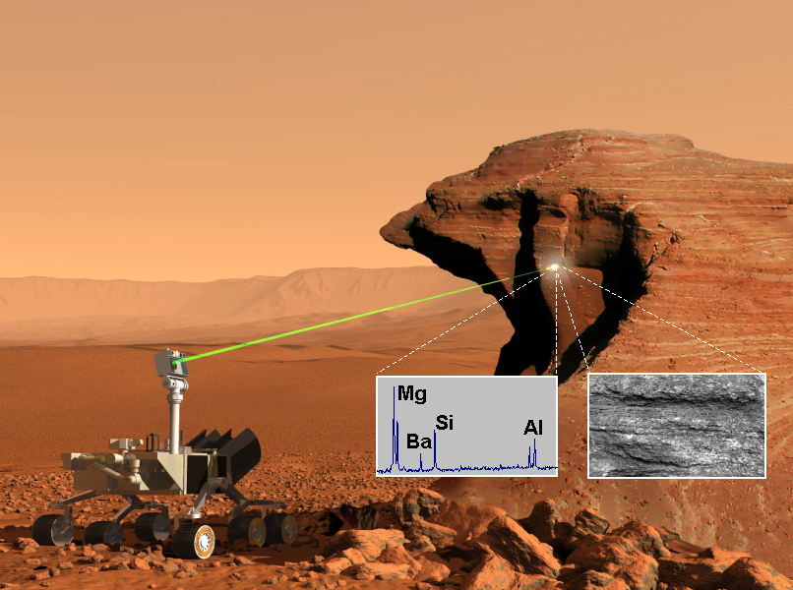
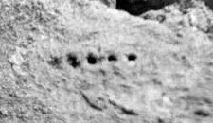
Spot size ~1 mm
‘Beechey’ soil, sol 19

Slide 21
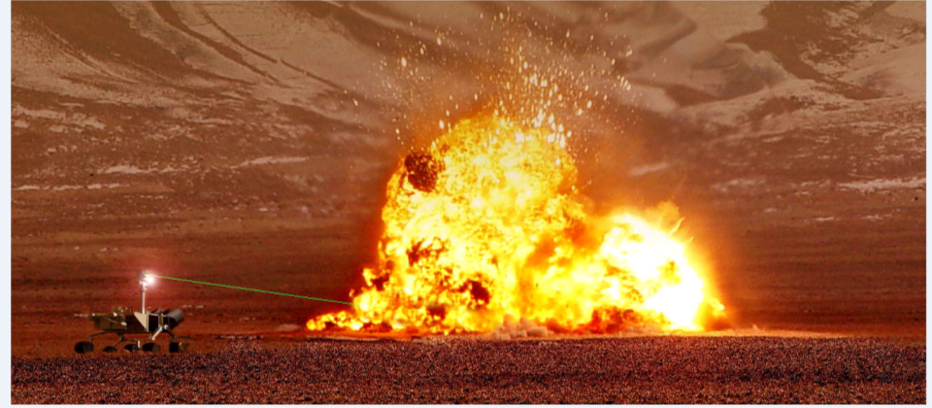
ChemCam in action
(We wish)

Slide 22
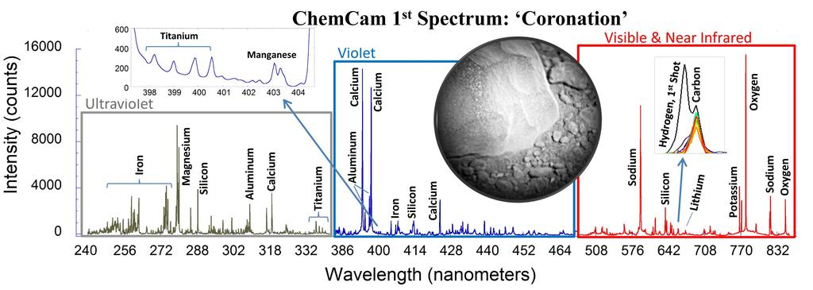
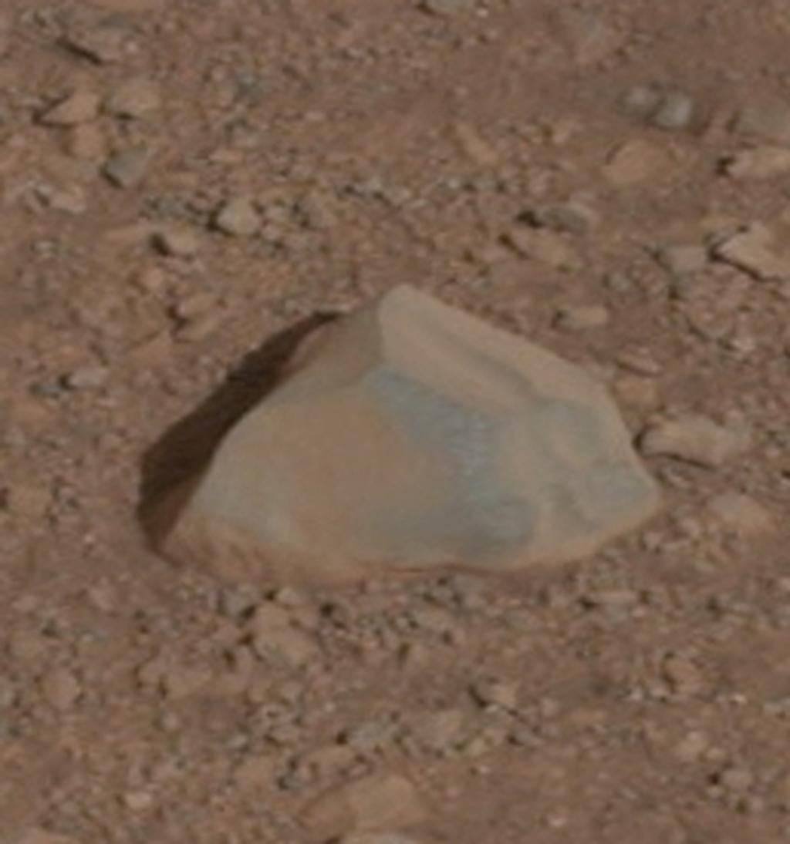
First ChemCam target Coronation, Sol 13
A beautiful spectrum!
Contains H in first shot
~6 cm
NASA/JPL-Caltech/LANL/CNES/IRAP/MSSS

Slide 23
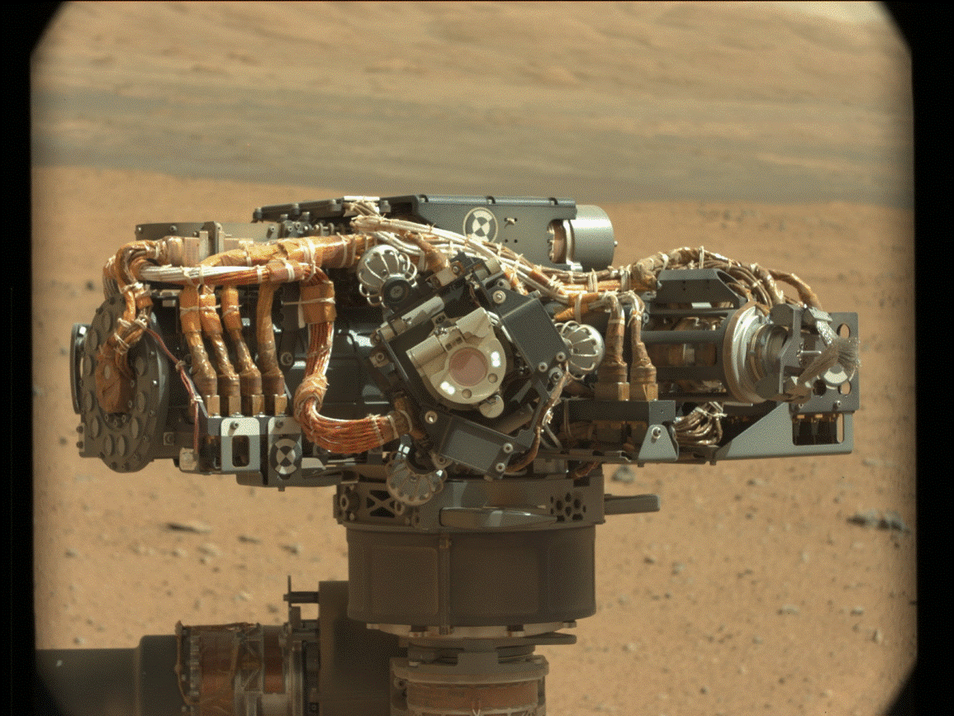
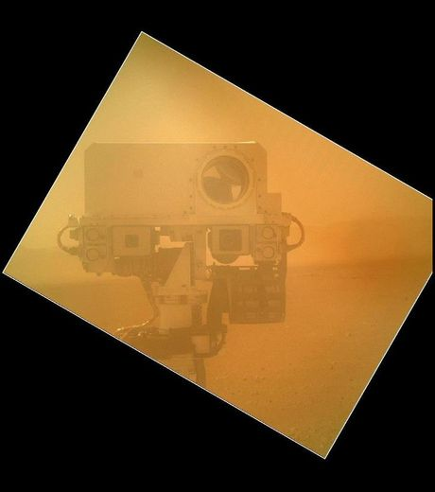
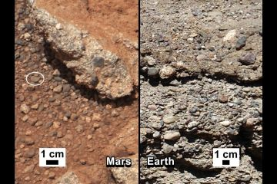
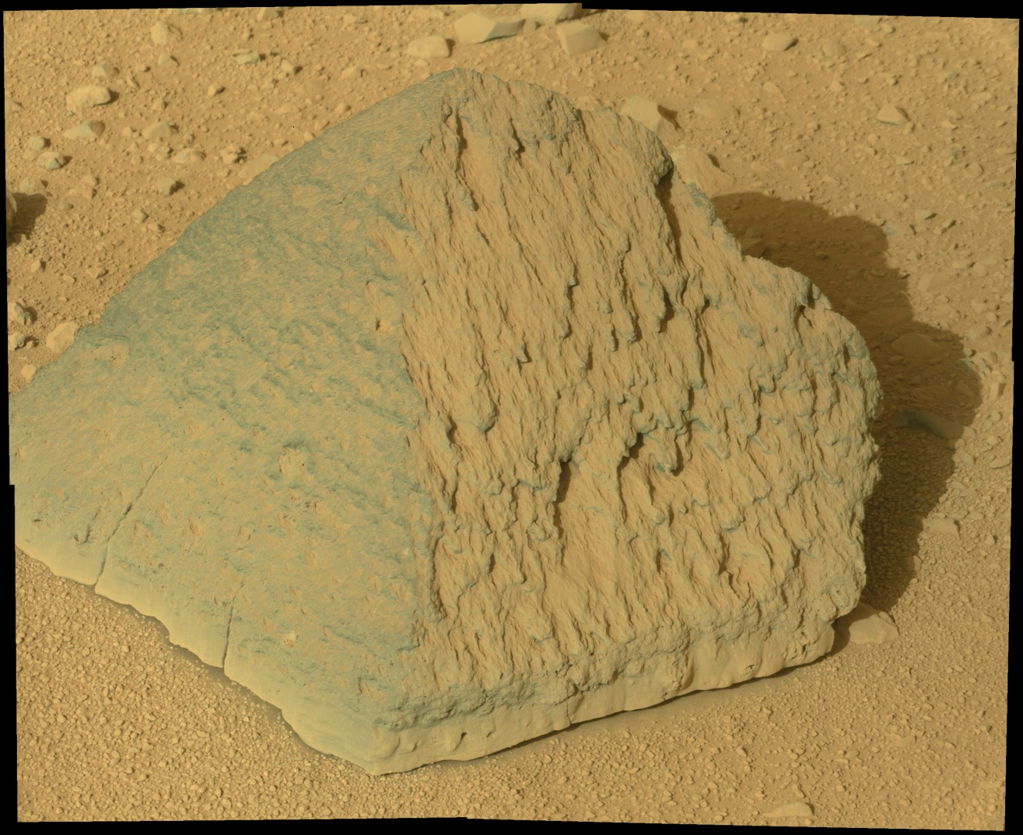
Robotic test: beautiful pictures of the rover!
ChemCam!
Several kinds of rocks observed

Slide 24
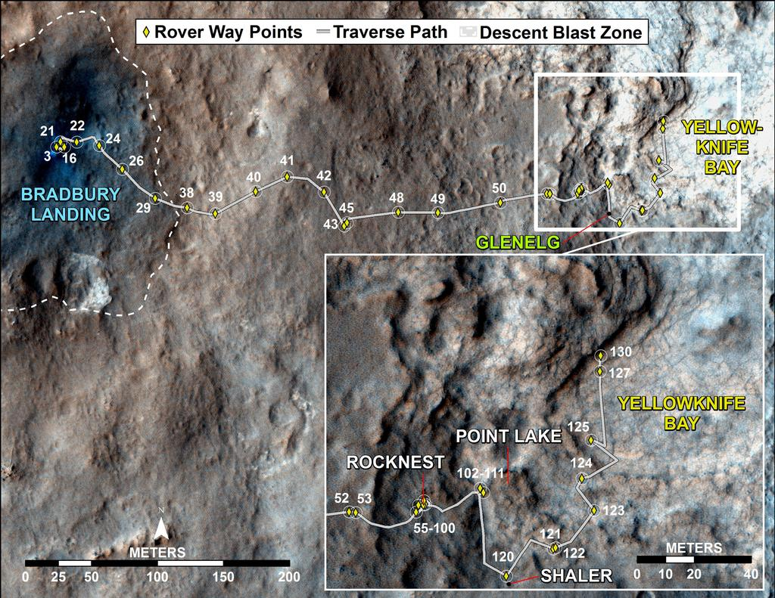
Current status: Today is sol 203
NASA/JPL-Caltech/Univ. of Arizona

Slide 25
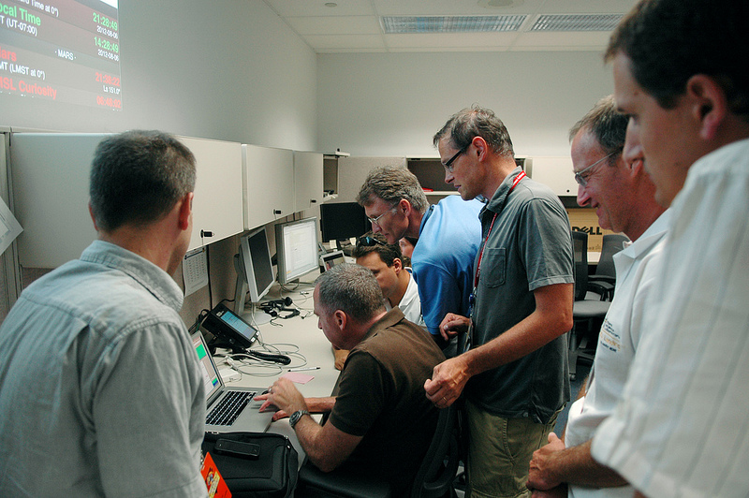
How do you drive a Mars rover?
Answer: From your laptop

Slide 26
Driving the rover
First 90 sols at Jet Propulsion Lab (JPL) in CA
On Mars time!
Now at home institutions, CA time (7 days/week)
Long-term goals are planned in advance
Daily science experiments decided by science team
Look at data returned from yestersol
Select new targets for analysis
Write spacecraft commands in JPL software
Many, many meetings to check work
Could break rover
Delay long-term goals
Science discussion at the end of the sol

Slide 27
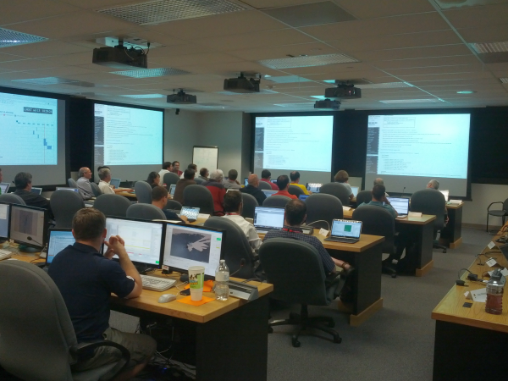
At the science kickoff

Slide 28
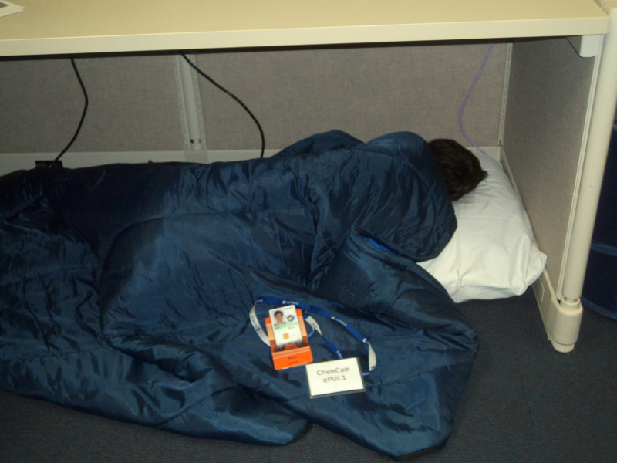
~5am, still one meeting to go

Slide 29
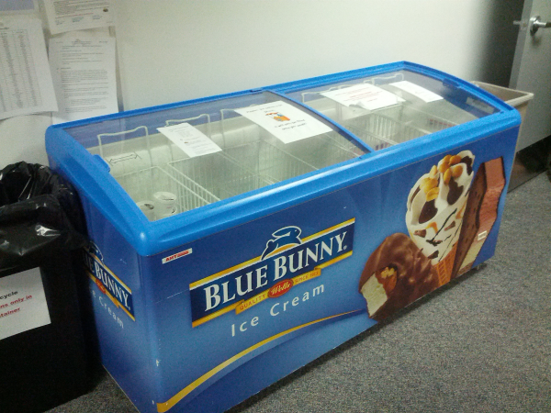
Free ice cream!

Slide 30
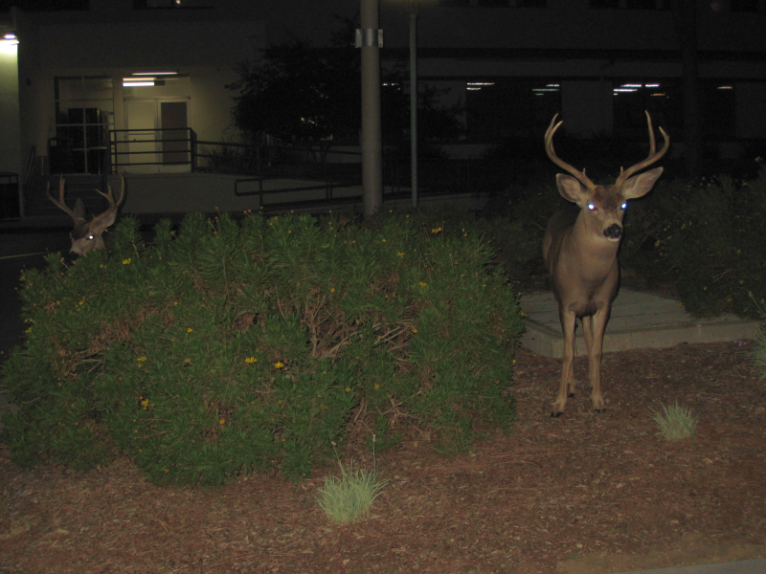
Leaving JPL at ~4 am

Slide 31
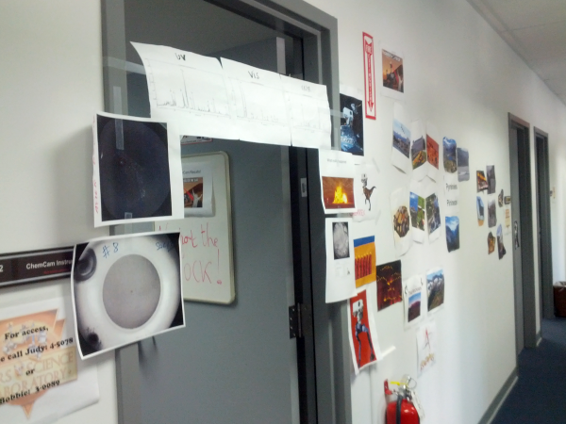
ChemCam ops exterior
ChemCam ops
CheMin
REMS

Slide 32
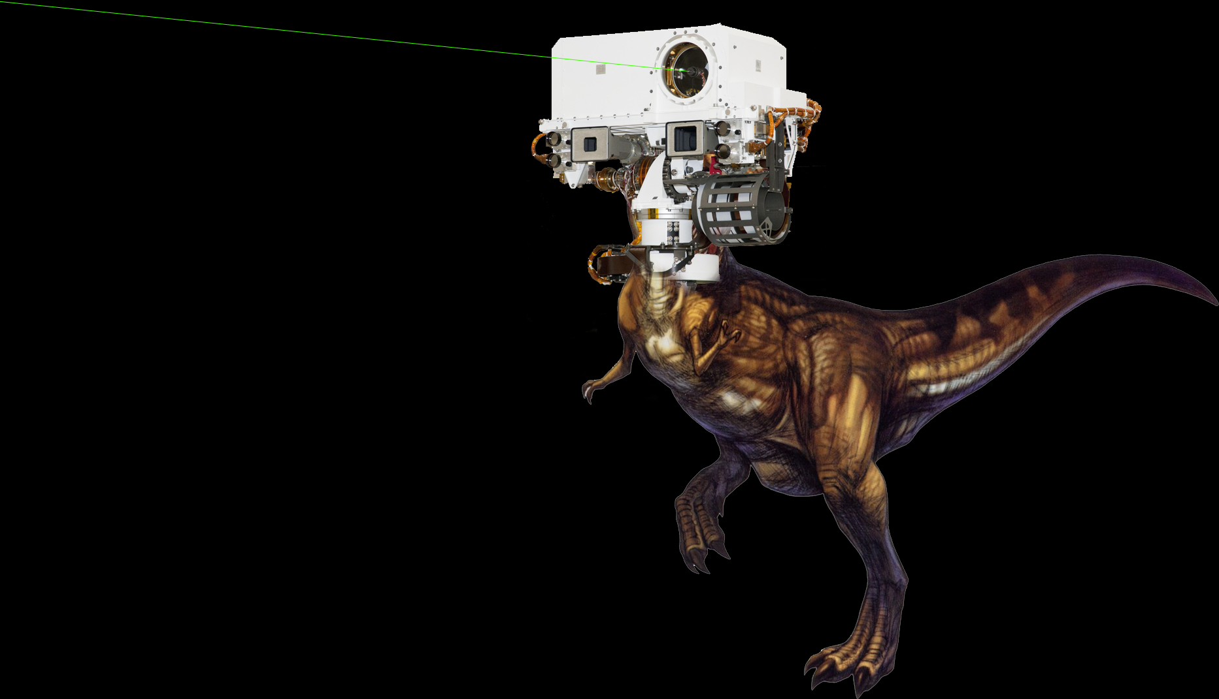
ChemRex

Slide 33
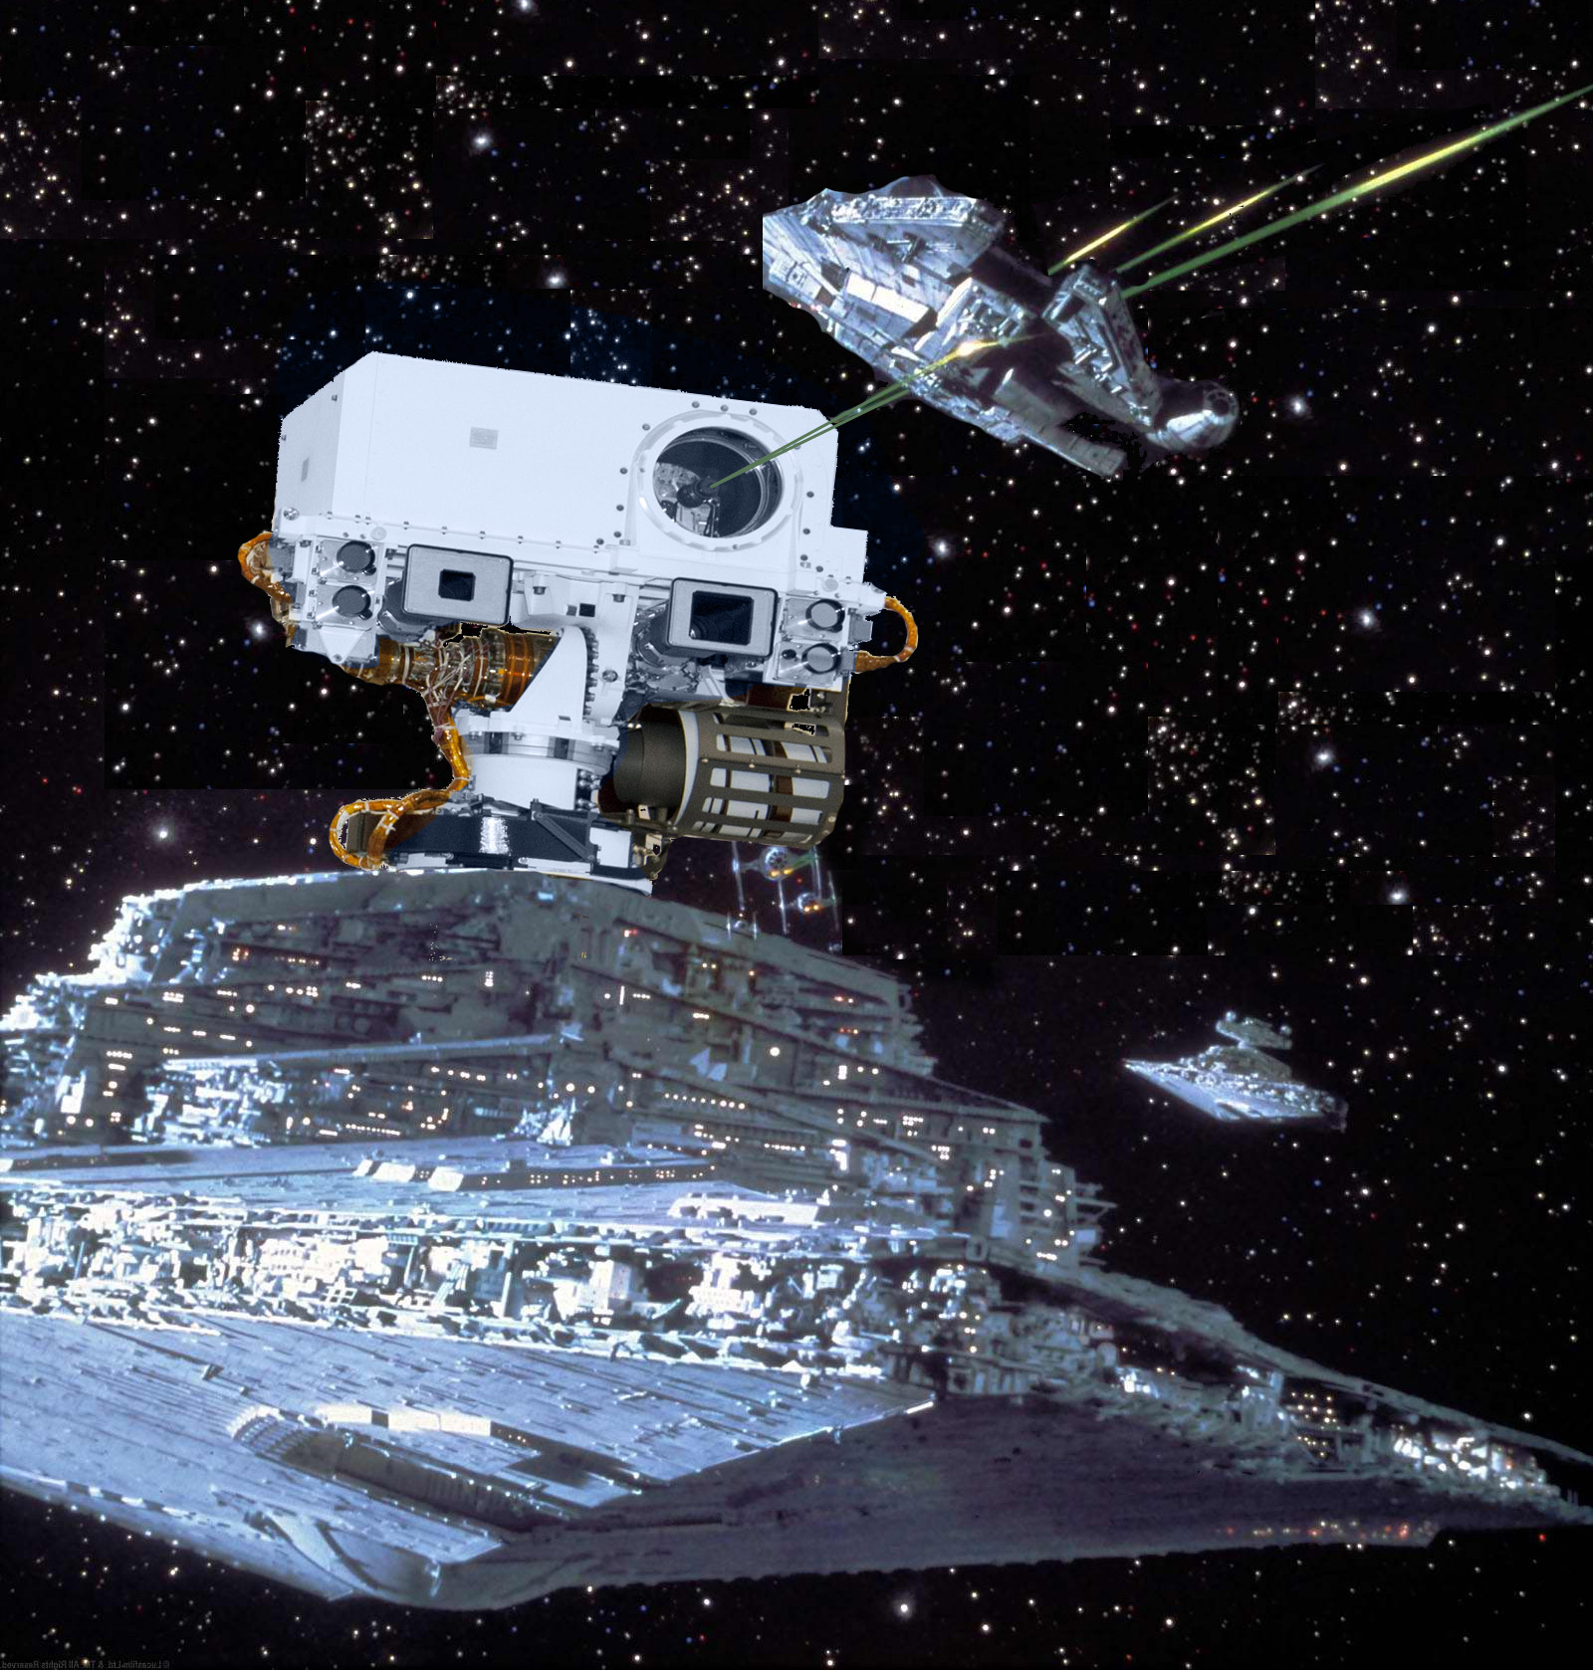
ChemDestroyer

Slide 34
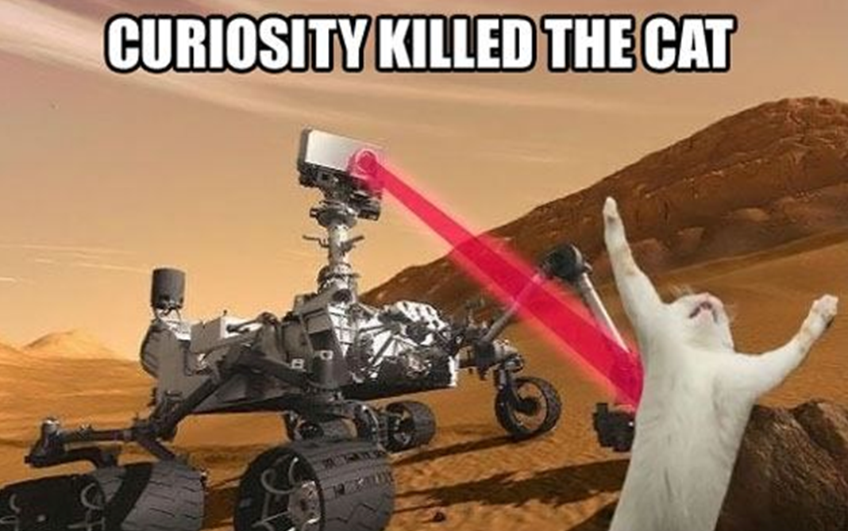
French: “Why do people think that ChemCam will hurt cats?”

Slide 35
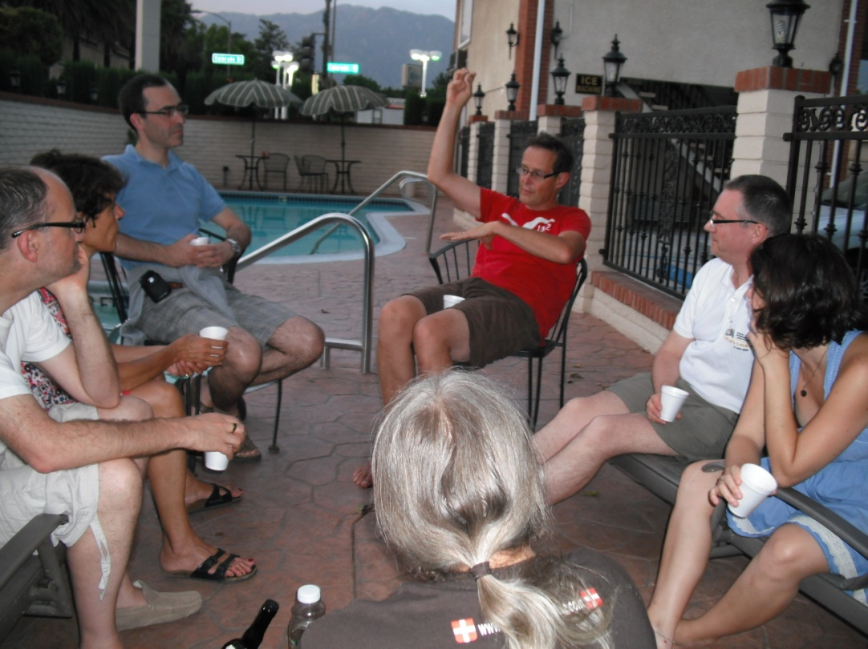
Some discussion close to the pool

Slide 36
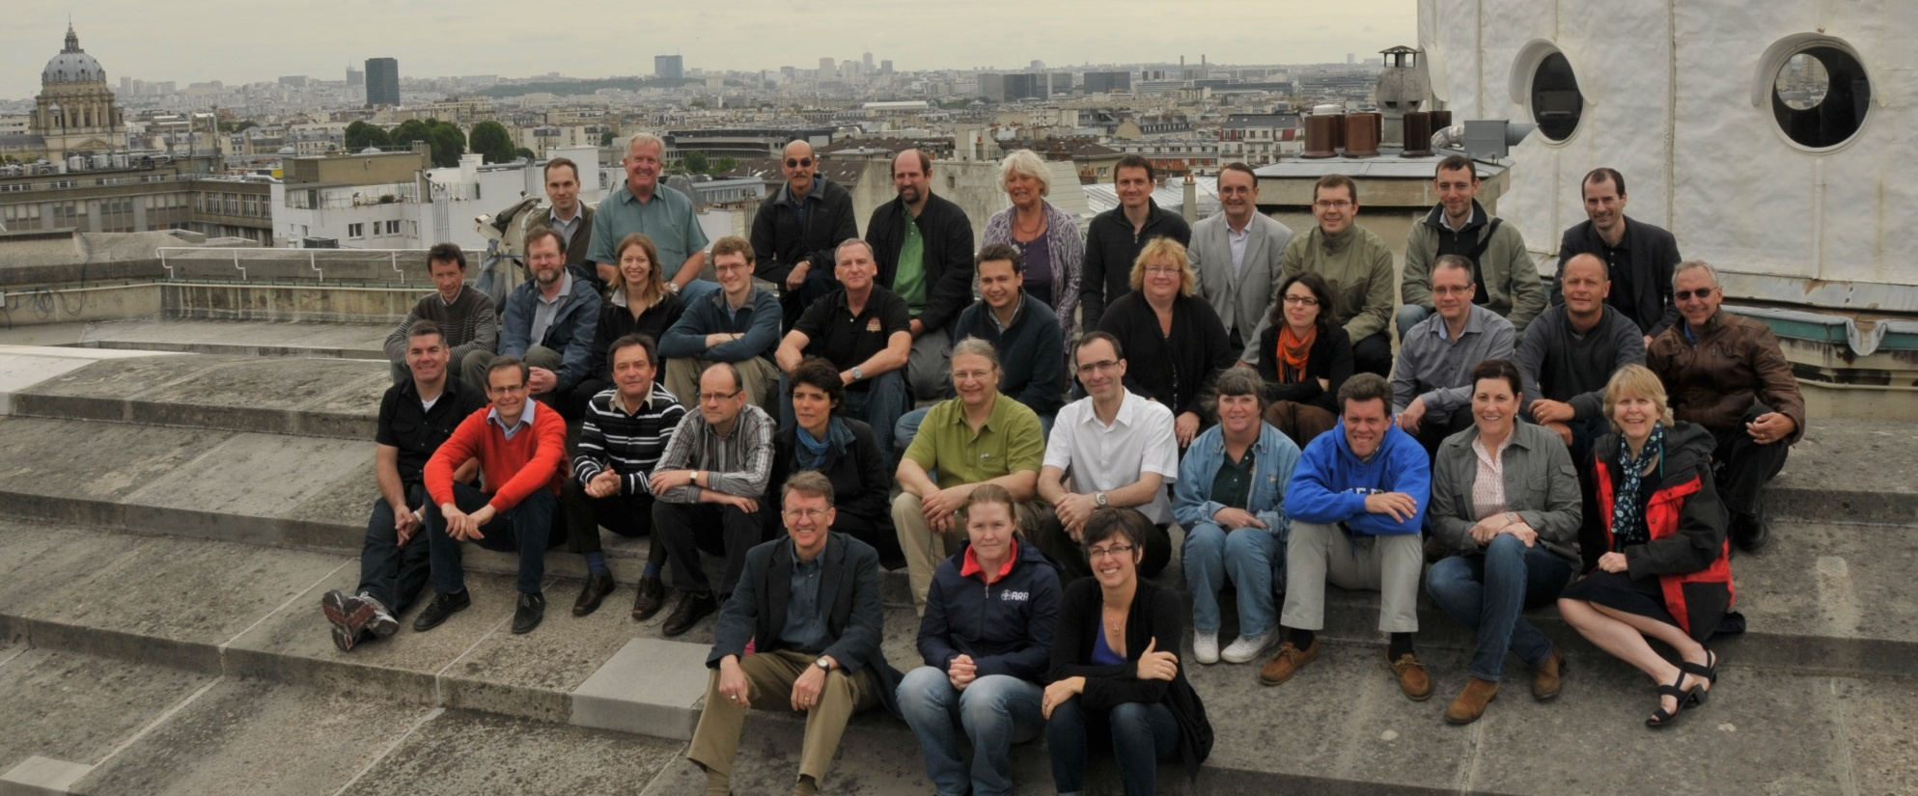
U.S. – France collaboration Observatoire de Paris, June 2012
10 women out of 35 team members = 28%
Probably less for entire team

Slide 37
How did I get here? Nina’s story
Saw Halley’s comet in 1986 and was hooked
Took astronomy at Winsor and loved it
Majored in astronomy in college (Smith College)
Wasn’t sure about grad school
Didn’t think I was good enough (!!!)
Question: What do I really like learning about?
Science fiction
Spaceships
Aliens
Conclusion: I should study Mars
Then, I called up a planetary researcher at LANL and asked for a job
Worked at LANL as a post-bac student
Went to grad school in geology
Wesleyan University, University of New Mexico

Slide 38
How did I get here, in France? Agnes’ story
Always have been passionate about space in general and spaceships
I participated several times in astronomy summer camps, as a kid and then as teacher
College: Engineering for spaceships or science ??
I tried Engineering first ! But changed my mind…
Majored in geology in college
Master’s degree in planetary science

Slide 39
How can *you* get here? Or wherever you want to be
You don’t have to be “good,” you just have to love it
Experts = ~10,000 h of practice (5 years)
You can learn anything if you put in the time
Research is about answering questions that no one knows the answer to
You aren’t dumb if you don’t know the answer!
Can be good at research and not school
Don’t limit yourself to things that are easy
You will have to work hard
But the rewards are worth it
Be persistent

Slide 40
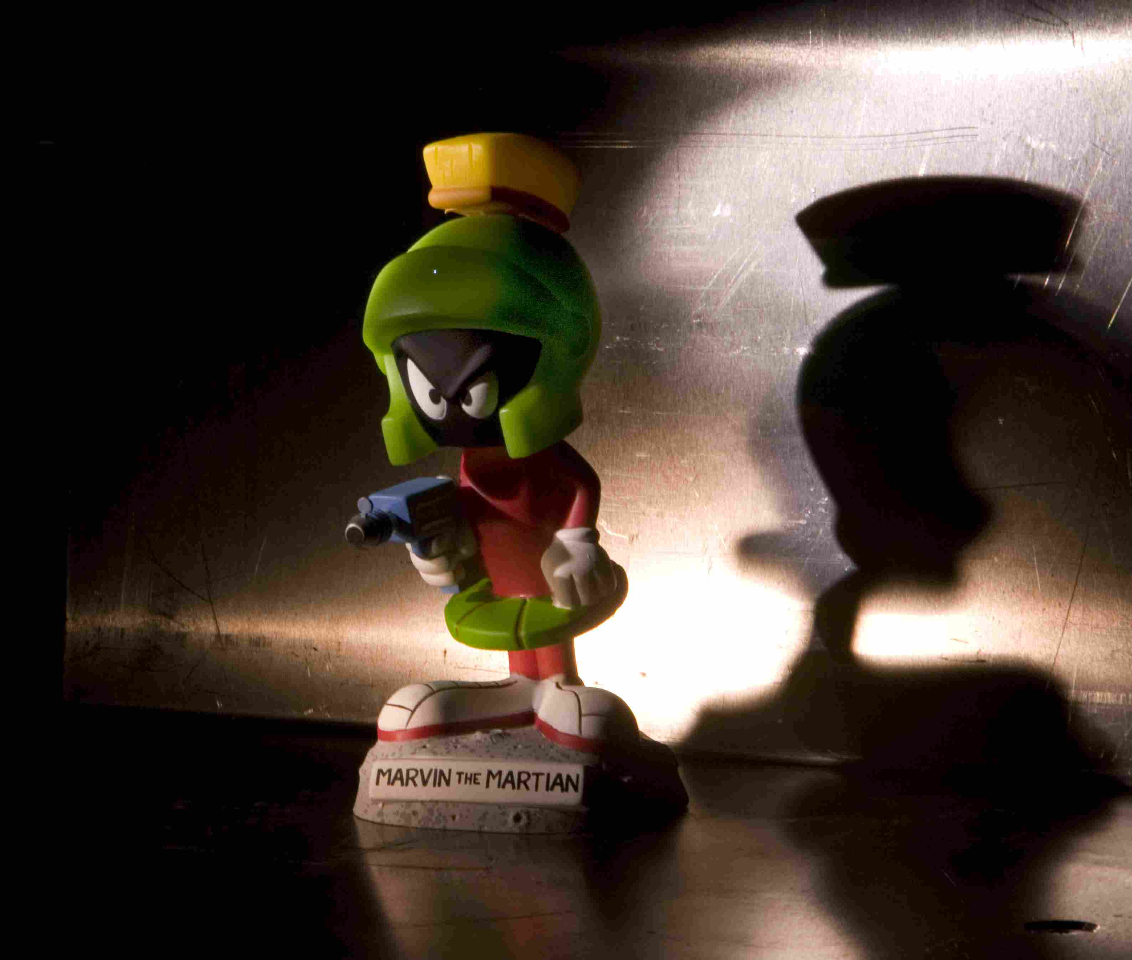
Questions?
LIBS spot

Slide 41
Backup slides

Slide 42
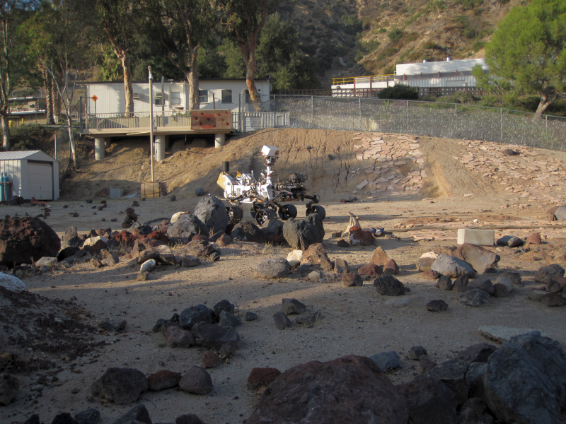

Slide 43
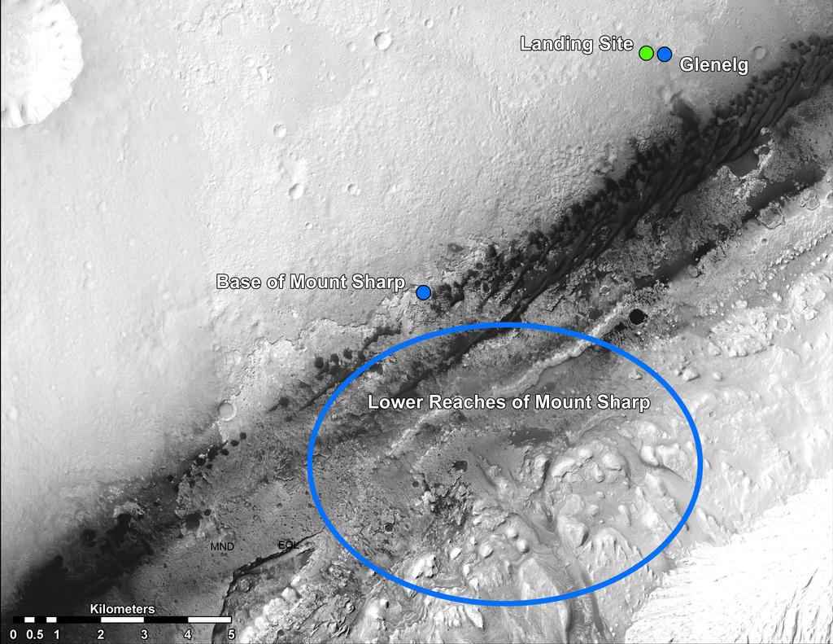
Where are we headed?
NASA/JPL-Caltech/Univ. of Arizona

Slide 44
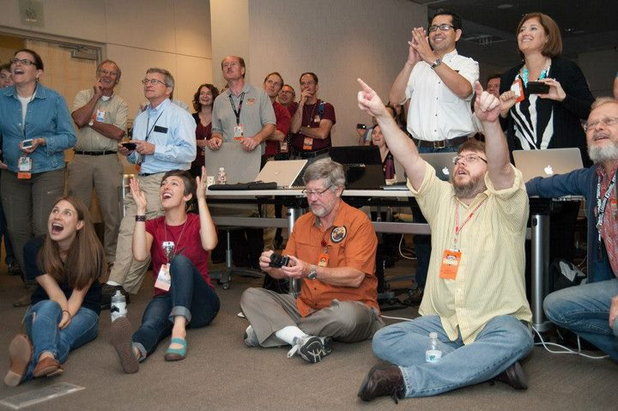
Landing night

Slide 45
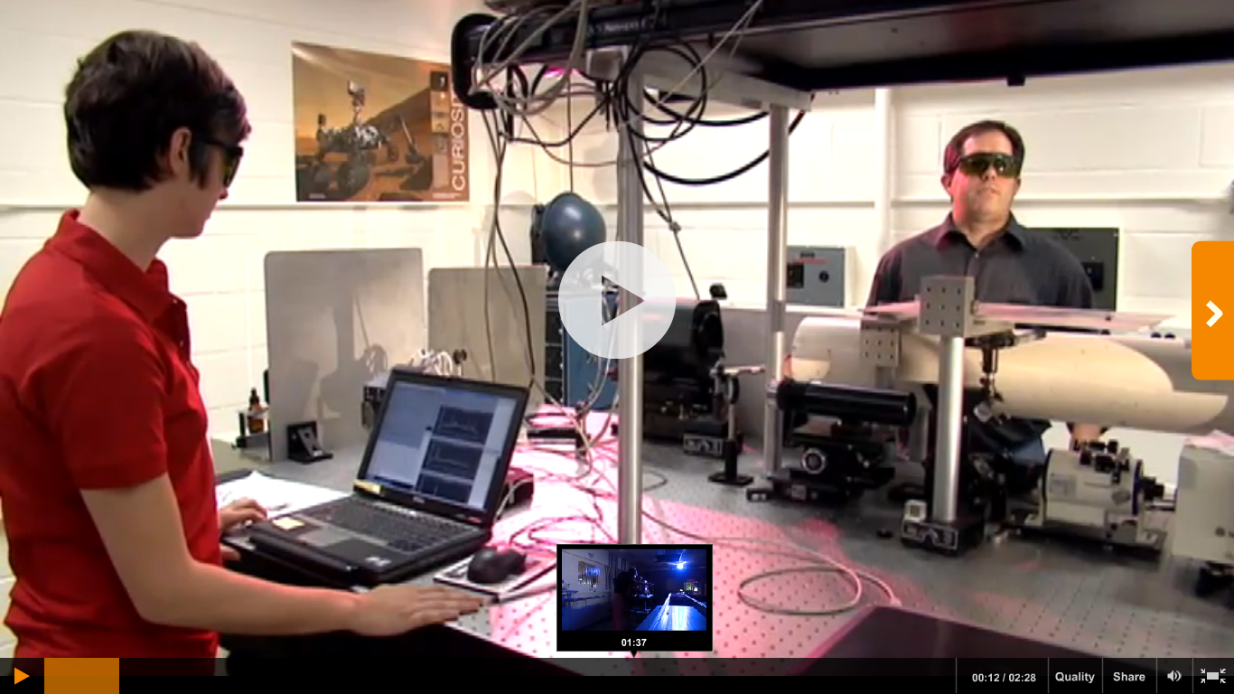
ChemCam on Discovery (2:28)
http://science.discovery.com/videos/mars-landing-2012-chem-cam.html

Slide 46

Curiosity rover report
http://www.youtube.com/watch?v=iDgv14Qtl1c&list=UUryGec9PdUCLjpJW2mgCuLw&index=21

